Slide 1


Slide 2
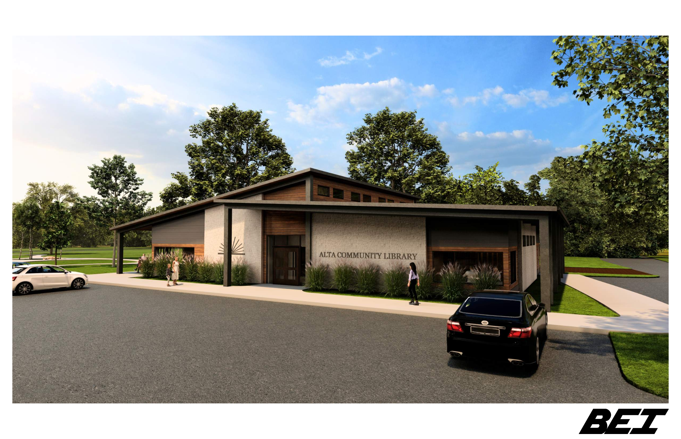
Visual concept: Library front entrance; building at north end of park.

Slide 3
Ballot question:
“Shall the City of Alta, in Buena Vista County, State of Iowa, enter into a loan agreement and issue general obligation bonds in an amount not exceeding $1,250,000 for the purpose of paying the cost, to that extent, of constructing, furnishing and equipping a municipal library?”
Financial facts:
The proposed library will cost residents approximately $0.6522 per $1,000 of net taxable value
This is less that 2/3rds of one cent per $1,000 of net taxable value over 18 years

Slide 4
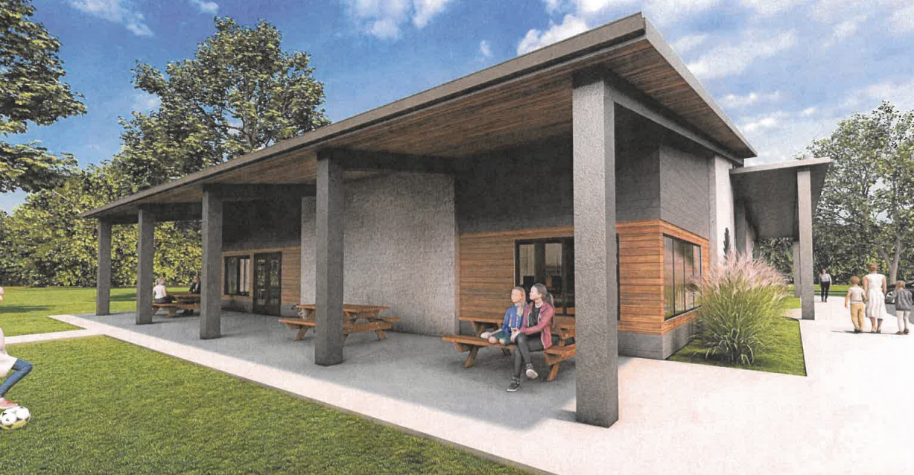
View of east side, next to Service Members Memorial Garden Walking Path.

Slide 5
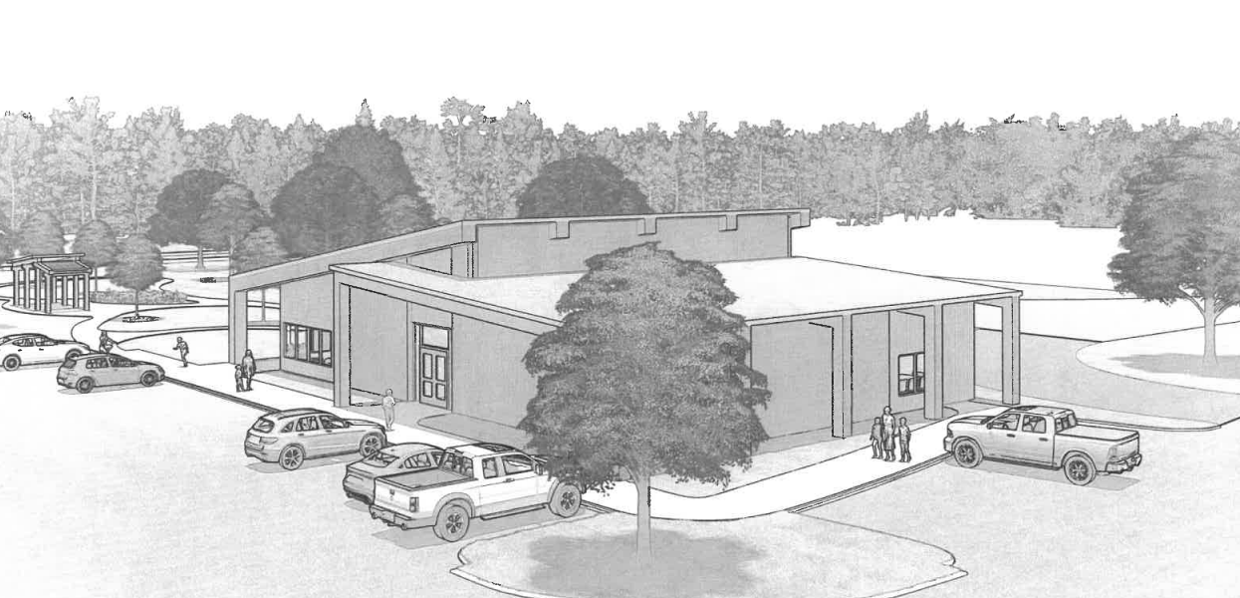
Visual concept: Library building from corner of 7th & Veterans Drive.

Slide 6
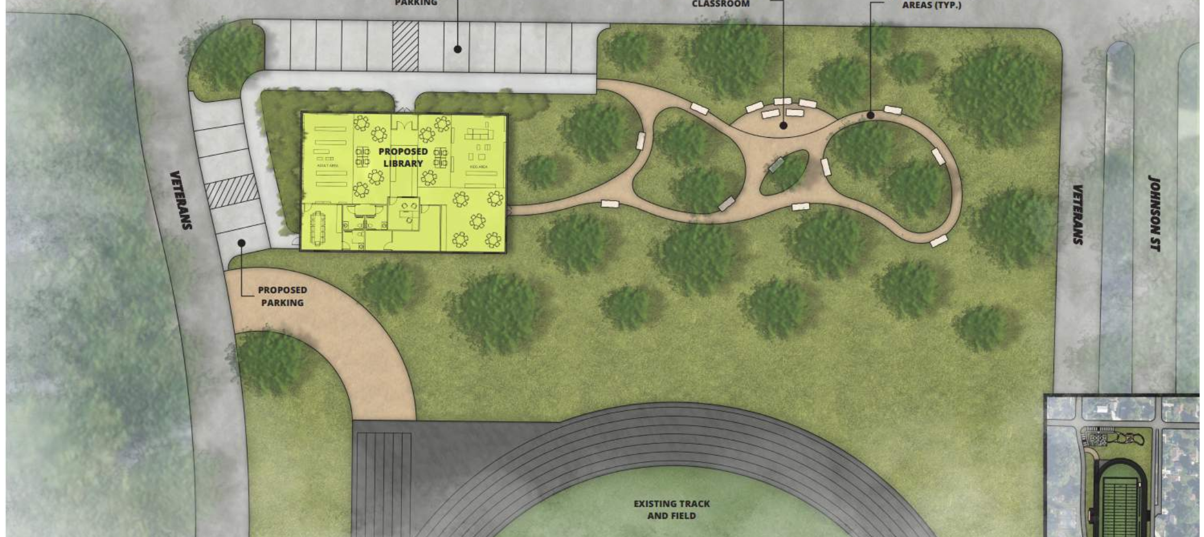
Concept of Library & Service Members Memorial proposals at north end of park.

Slide 7
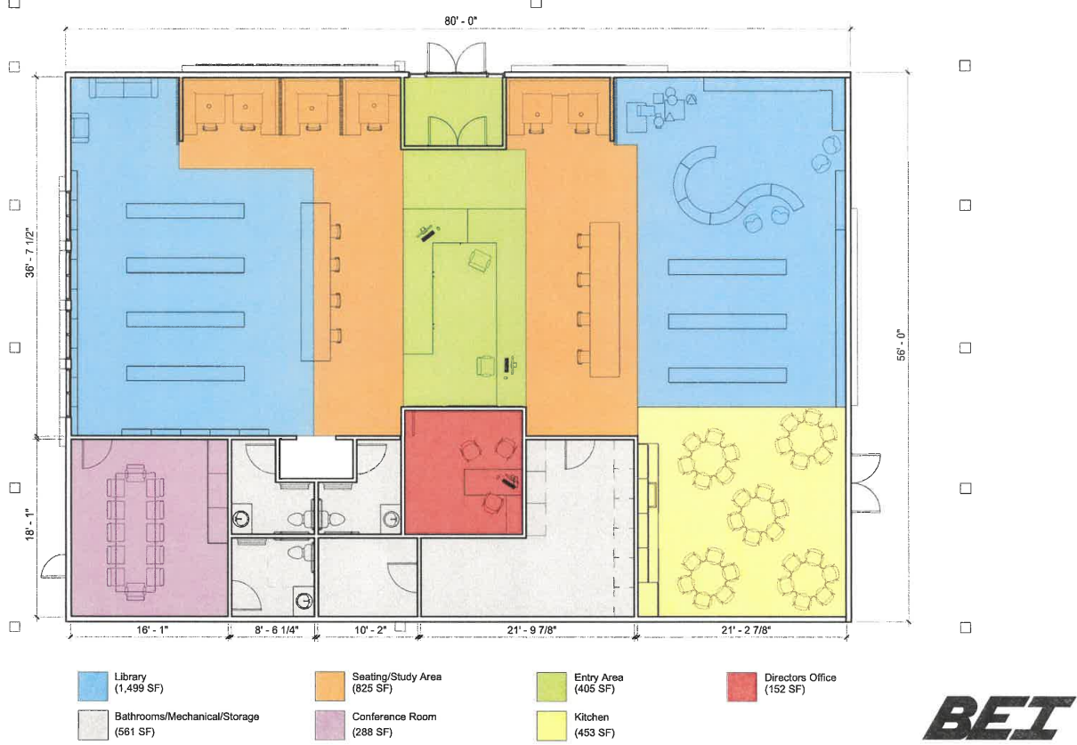
Proposed interior floor plan for library, main entrance facing north.

